Slide 1
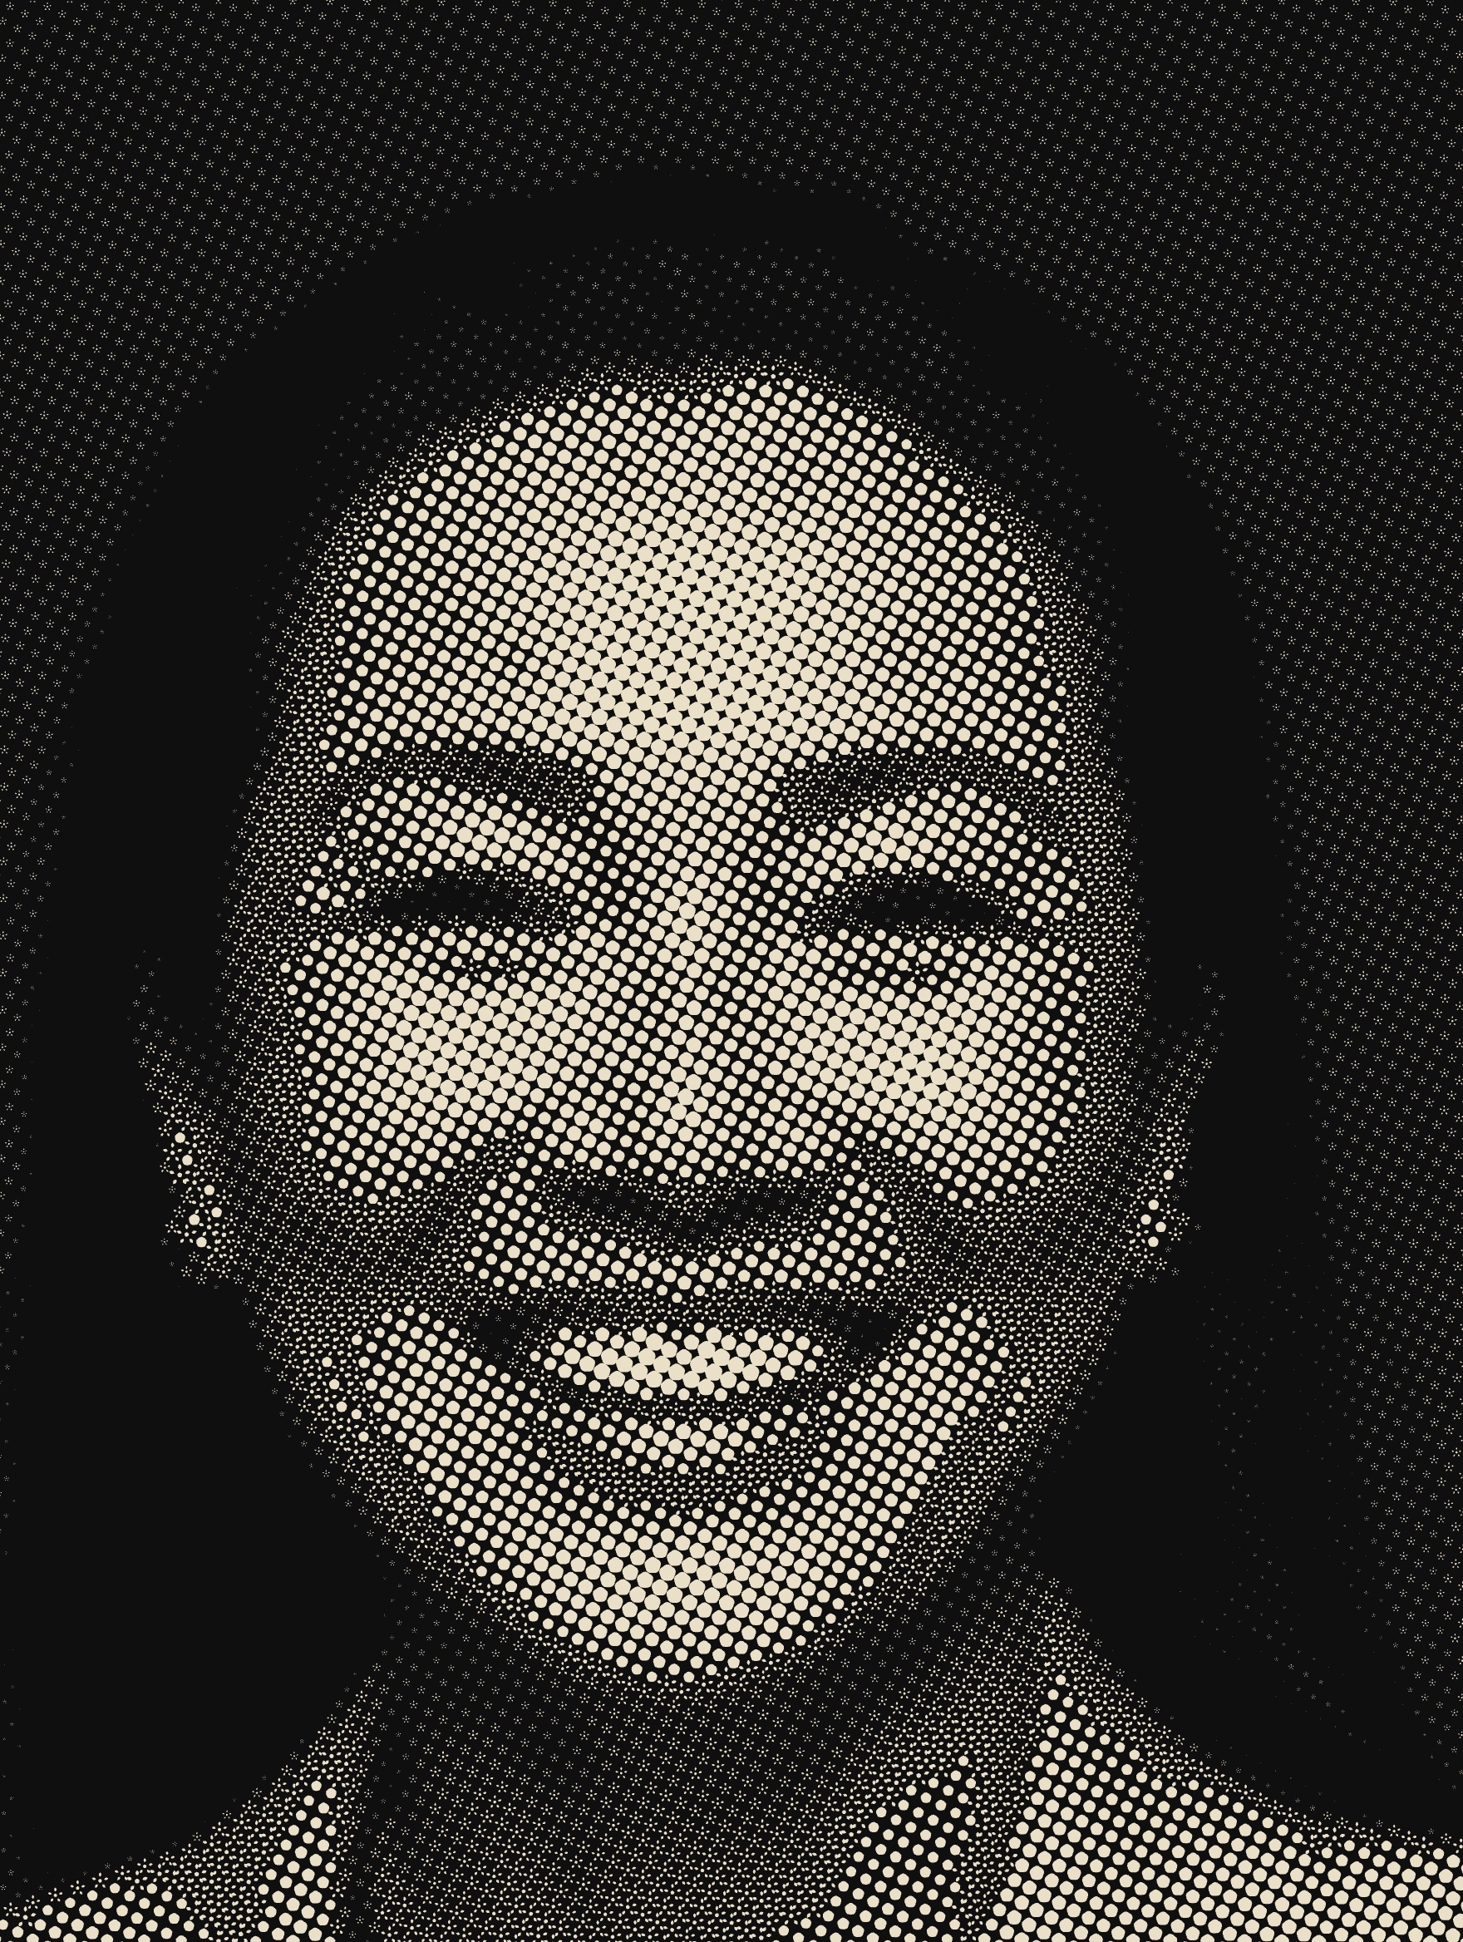
A TEST · NOT A RULING
The dot is
the mark.
A halftone reproduces tone by varying the area of a dot. This screen varies the area of the Quintessence instead. Every dot in the image is the rounded pentagon core, or the whole rosette where the light allows it. There is not a circle anywhere in the picture.
Photography rendered in the brand, at every scale.

Slide 2
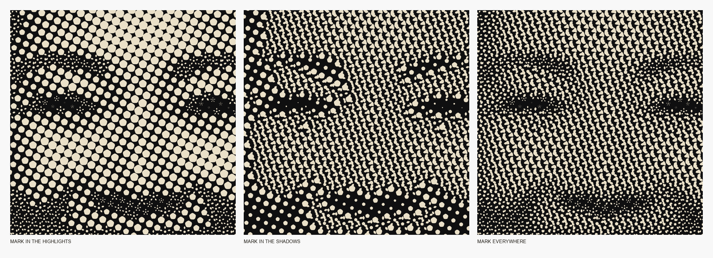
Five Points Digital Studio
The screen
2026
pg 2
How it works
Four decisions make the difference between a brand-shaped novelty and a screen that actually reproduces a photograph.
01
02
03
04
No circles
Area, not width
The mark blooms
in the light
One ink, one ground
Every dot is the pentagon core or the whole rosette. The mark carries the image rather than sitting beside it.
The rosette inks 19% of its own circle. The core inks 50%. Both are sized from measured ink, so the screen can change shape mid-image without a step in tone.
The rosette takes the highlights, where a dot has room to open. The core takes everything darker. Tested against the reverse, below.
A screen is a single ink. Bone on ink, ink on paper, or a voice on paper. Never two inks in one image.
The test that settled it. Put the whole mark in the shadows and the rosettes overlap into noise; the face stops reading. Put it everywhere and tone flattens. The mark belongs in the light.

Slide 3
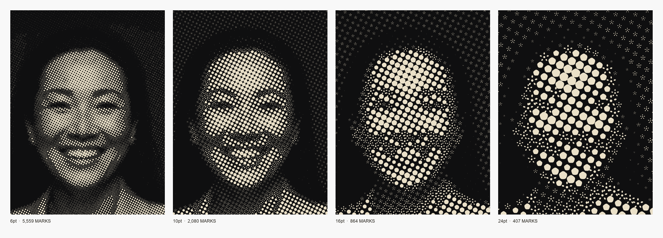
Five Points Digital Studio
The screen
2026
pg 3
The ruling
Ruling is the one control that matters. Coarsen the screen and the mark becomes the subject. Fine it down and the photograph does.
Six point for photography that must read as photography, in a report or on a page beside body copy. Ten point as the house setting for documentation imagery. Sixteen and above for statements, where the mark should be unmistakable and the sitter is a gesture rather than a likeness.

Slide 4
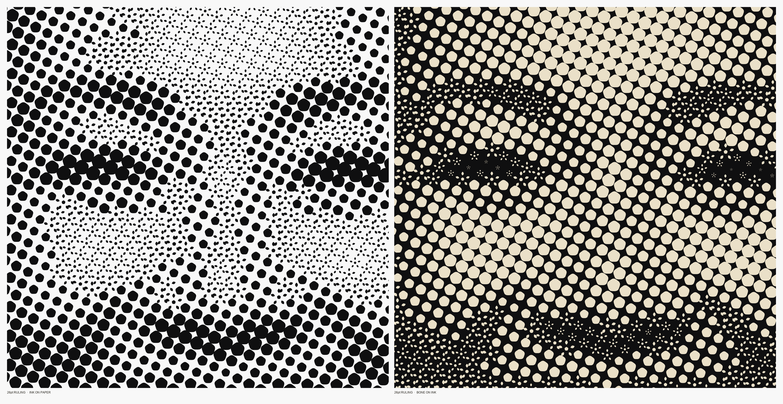
Five Points Digital Studio
The screen
2026
pg 4
At the dot
The same eye at a twenty-six point screen, either way round. The pentagons carry the midtones. In the lightest passages they give way to the rosette itself.

Slide 5
Five Points Digital Studio
The screen
2026
pg 5
What it needs
The screen is built and calibrated. Three things stand between it and use.
Photography
Where it runs
The register
This is the binding constraint, not the screen.
The asset library holds four stock portraits. They are AI-generated, two carry visible watermarks, and none of them is a tradesperson.
A screen this strong makes the source obvious rather than hiding it. It wants real photography of real people in the trades, shot with clean tonal separation: a light subject against a dark ground, or the reverse. Busy environmental shots screen badly, as the one environmental shot in the library does.
My recommendation: every photograph in the identity book, the capabilities deck and the proposal runs screened. No unscreened photography anywhere in the documentation.
That makes it a system rather than an effect, and it removes the question of when to use it, which is the question that kills features like this.
The site is a separate decision, since the screen costs bandwidth and needs care at small breakpoints.
Bone on ink is the strongest of the treatments and the most on-brand. I would make it the default and reserve ink on paper for pages that are already light.
A voice-coloured screen, coral or ash green on paper, works and is held in reserve for section dividers.
One open question worth your ruling: whether the screen is a house treatment applied to everything, or a device reserved for people, with product and place shot straight.
The engine is parametric: source, ruling, angle, shape, levels and colourway are all arguments. Once the photography exists, screening the whole library is one pass.

